Slide 1

Nonparametric First Passage Time Distribution Estimation for Degradation Data with Random Effects
Lochana Palayangoda, PhD
Assistant Professor of Data Science and Statistics
Department of Mathematical and Statistical Sciences
University of Nebraska at Omaha
May 2025
LiDA 2025

Slide 2




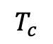
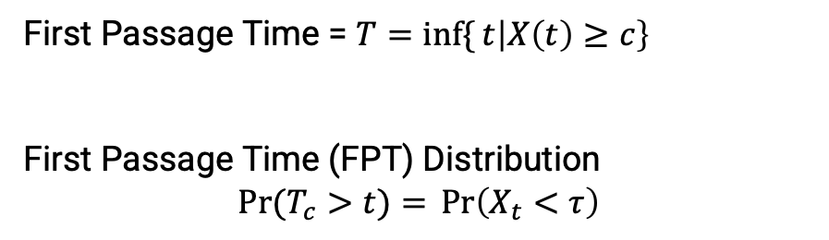

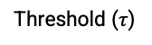
Highly reliable products last for long time but their performance subject to degradation over time
Year 0
Year 1
Year 2
Year 3
Degradation Data ➔ Estimate the Lifetime
First Passage Time = $T=\inf{\{}t\left|X\left(t\right)≥c\right\}$
First Passage Time (FPT) Distribution
$$\operatorname{Pr}{(T_{c}>t)}={\operatorname{Pr}\left(X_{t}<τ\right)}$$
Threshold ($τ$)
Light Output Degradation ($X_{t}$)
Experiment limit
$$T_{c}$$
Time
2
2

Slide 3
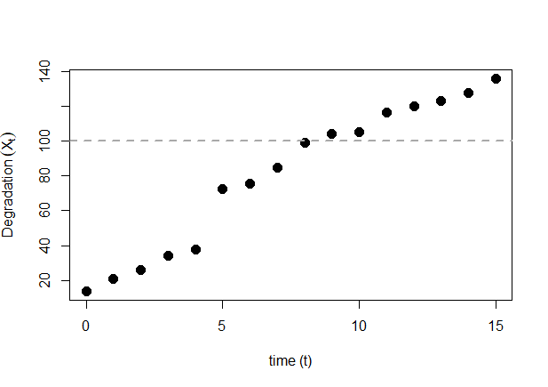
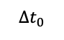
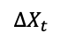
Parametric Lévy process based stochastic models are generally used for degradation modeling
Gamma process
$$X_{t}\text{\sim } \text{Gamma}\text{(}αt,ν\text{) }$$
𝑋_𝑡 "~ Gamma(" α𝑡,ν") "
Inverse Gaussian (IG) process
$$X_{t}\sim \text{Inverse} \text{Gaussian}\text{(}μt, λt^{2}\text{)}$$
𝑋_𝑡~" Inverse Gaussian(" μ𝑡, λ𝑡^2 ")"
$$ΔX_{t}$$
$$Δt_{0}$$

Slide 4
Fixed Effect versus Random Effect Random effect (heterogeneity) modeling accounts for unit-to-unit variability
Degradation
Degradation
Time
Unit 1
Time
Fixed Effect
Random Effect
Unit 2

Slide 5
Studies on Parametric Degradation Data with Random Effects
Gamma Process with Random effects
Inverse Gaussian Process with Random Effects
Lawless and Crowder (2004); Tsai et al. (2012)
Peng (2015)

Slide 6
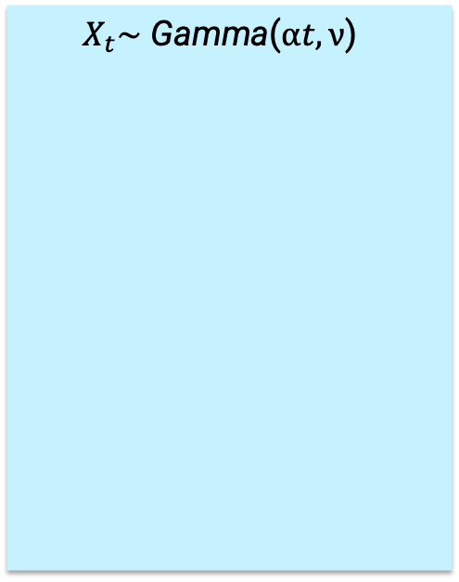
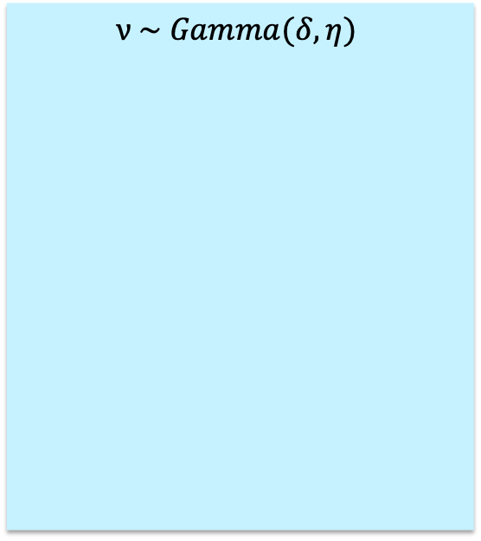
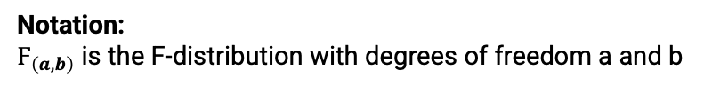
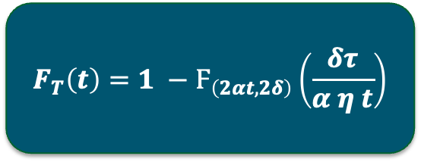

Gamma Degradation Process with Random Effects
$$X_{t}\text{\sim } \text{Gamma}\text{(}αt,ν\text{) }$$
$$ν \sim Gamma(δ, η)$$
First Passage Time (Failure Time) Distribution with Threshold Level $τ$
Gamma Process
Assume the rate parameter follows a probability distribution
$$F_{T}\left(t\right)=1 −Ϝ_{\left(2αt, 2δ\right)}\left(\frac{δτ}{α η t}\right)$$
Notation:
$Ϝ_{\left(a, b\right)}$ is the F-distribution with degrees of freedom a and b
Lawless and Crowder (2004); Tsai et al. (2012)

Slide 7
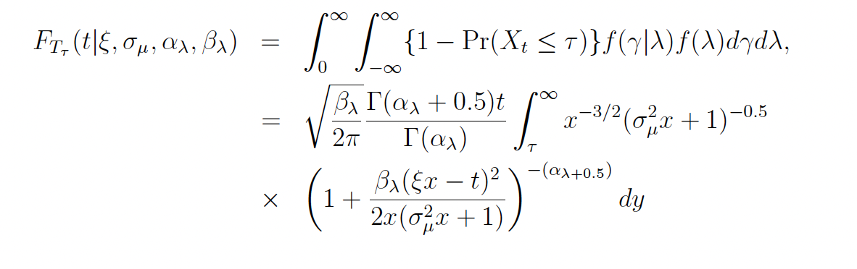

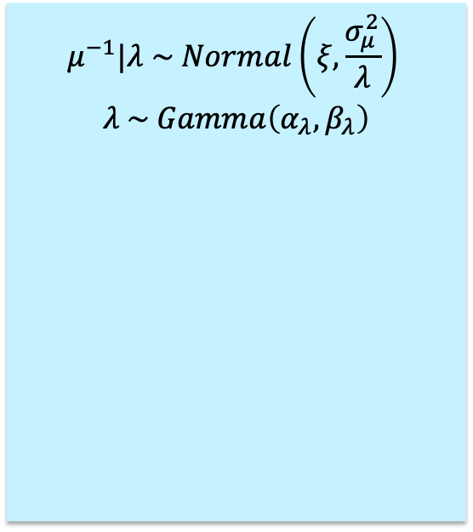
IG Degradation Process with Random Effects
$$X_{t}\text{\sim } \text{IG}\text{(}μt,λt^{2}\text{) }$$
$$μ^{−1}|λ \sim Normal\left(ξ,\frac{σ_{μ}^{2}}{λ}\right)$$
$$λ \sim Gamma\left(α_{λ},β_{λ}\right)$$
First Passage Time (Failure Time) Distribution with Threshold Level $τ$
IG Process
Assume that both mean and shape parameters follow a probability distribution
Peng (2015)

Slide 8
Empirical Saddlepoint Approximation (ESA)

Slide 9
Studies on Nonparametric FPT Estimation
Empirical saddlepoint approximation for degradation data with Random Effects
Balakrishnan and Qin (2017)
Improved empirical saddlepoint approximation for degradation data fixed effects
Palayangoda et. al (2020)

Slide 10
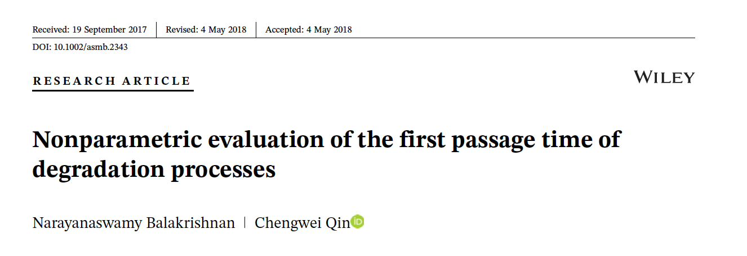

Studies on Nonparametric FPT Estimation with ESA
Develop an ESA approach to estimate the FPT distribution
Introduced procedures for both fixed and random effects
Effective mainly for the estimation of upper-percentiles
Improved the ESA method by Balakrishnan and Qin (2017)
Developed for only degradation data with fixed effects
Maintain the accuracy of the full FPT distribution.
Introduced the Conditional Random Imputation (CRImp) technique to apply the ESA with unequally spaced measurements

Slide 11
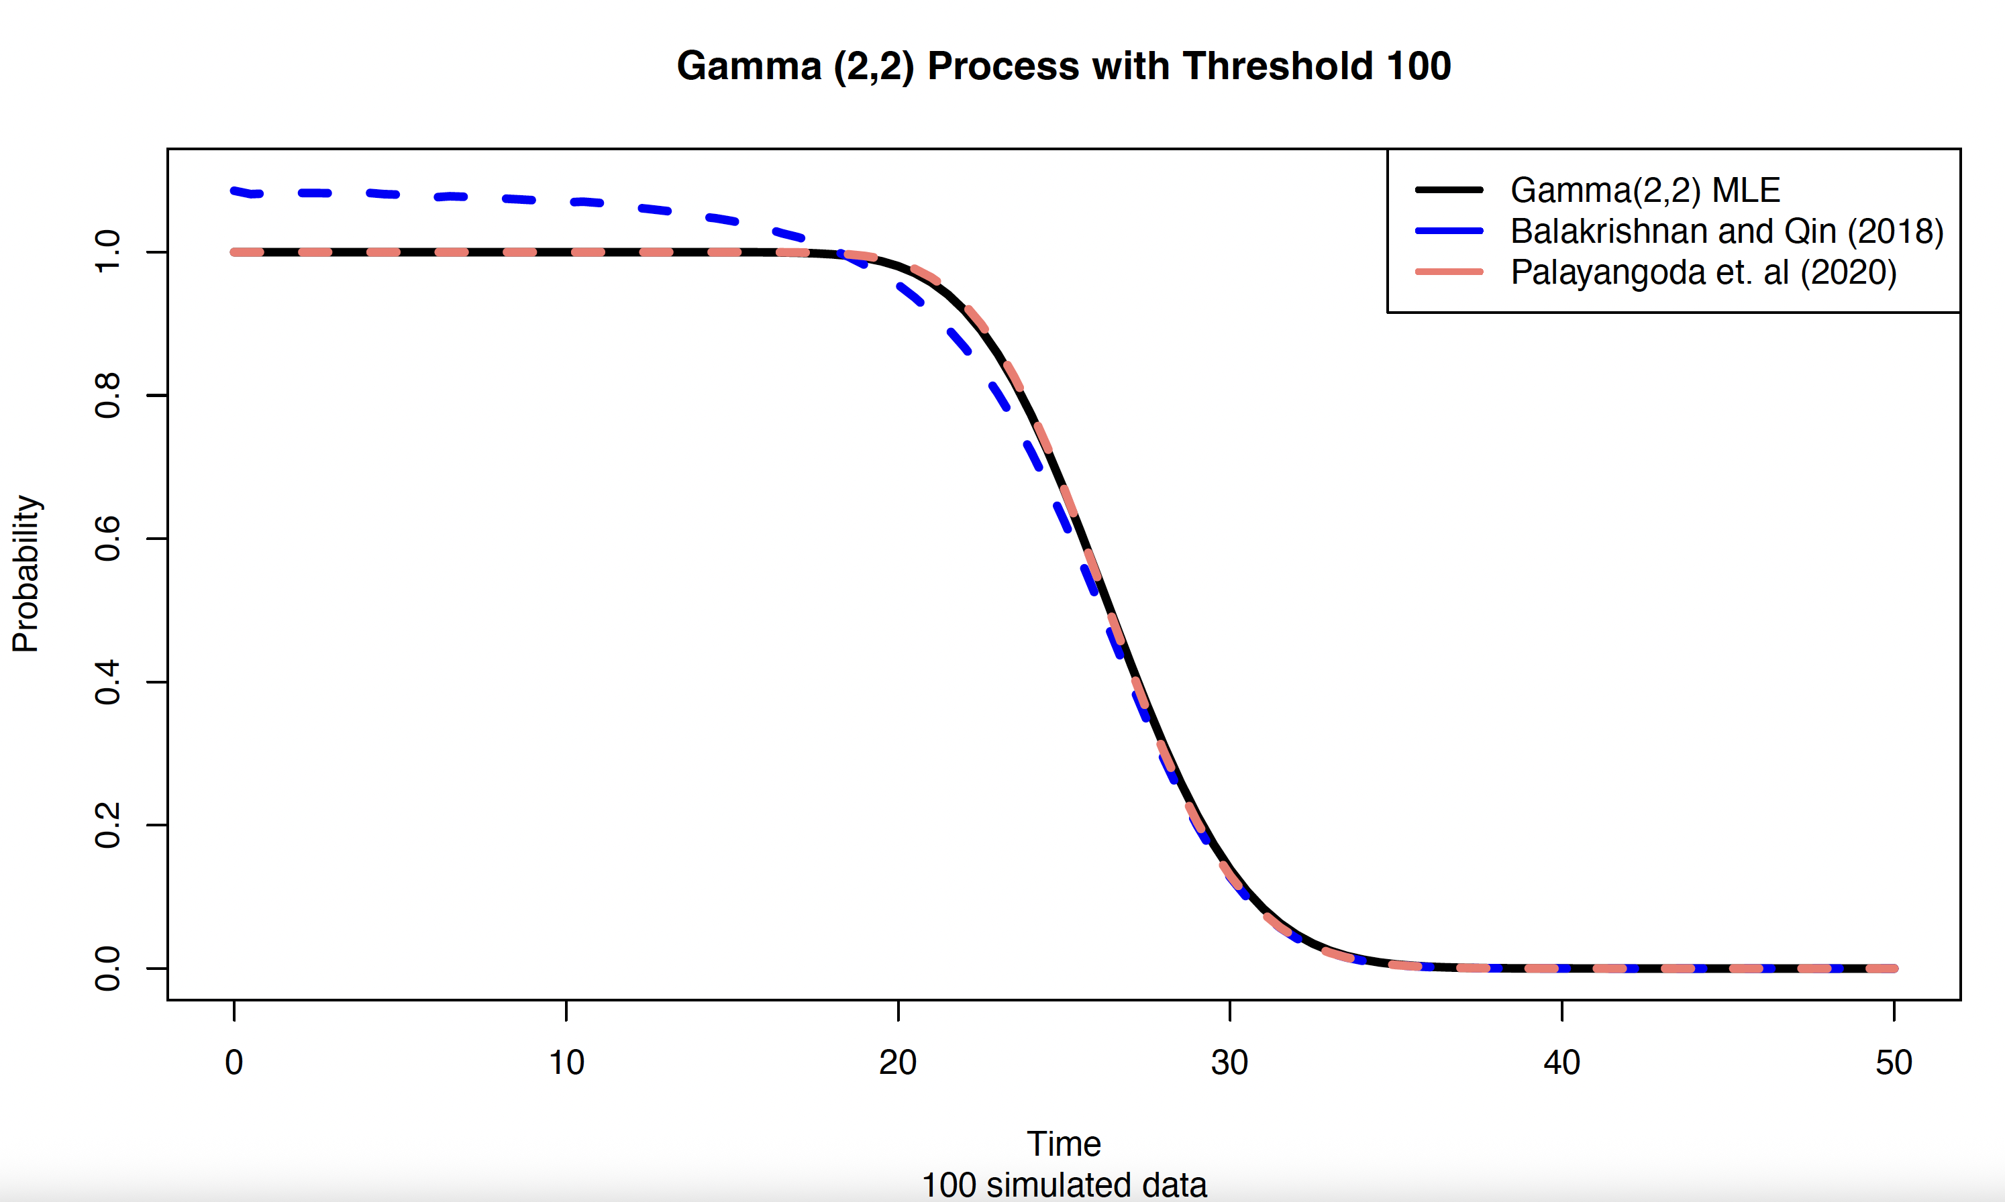
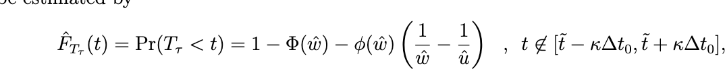
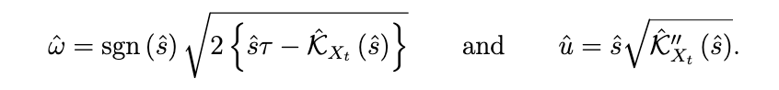
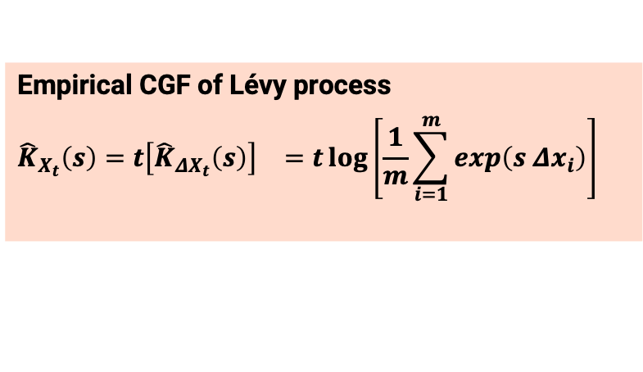

ESA Method enables to estimate of the FPT distribution without any distributional assumptions
Balakrishnan and Qin (2019), Palayangoda et al. (2020)
Saddlepoint Approximation
FPT Distribution
Degradation Data
Empirical Cumulant Generating Function of $X_{t}$
Empirical Cumulant Generating Function of 𝑋_𝑡
Empirical CGF of Lévy process
$${\hat{K}}_{X_{t}}\left(s\right)={t\left[{\hat{K}}_{ΔX_{t}}\left(s\right)\right]}^{}={t\log\left[\frac{1}{m}\sum_{i=1}^{m}{\exp\left(s {Δx}_{i}\right)}\right]}^{}$$
$\hat{s}$ is determined by solvingthe saddlepoint equation:
$$K_{X_{t}}^{′}\left(s\right)=τ$$
ESA method is a robust approach that can be used to avoid model misspecification errors (Palayangoda et al., 2020)

Slide 12
Random Effects with Empirical Saddlepoint Approximation Method (Random ESA Method)
Propose a distribution-free
random effect method
Simulations
Applications

Slide 13
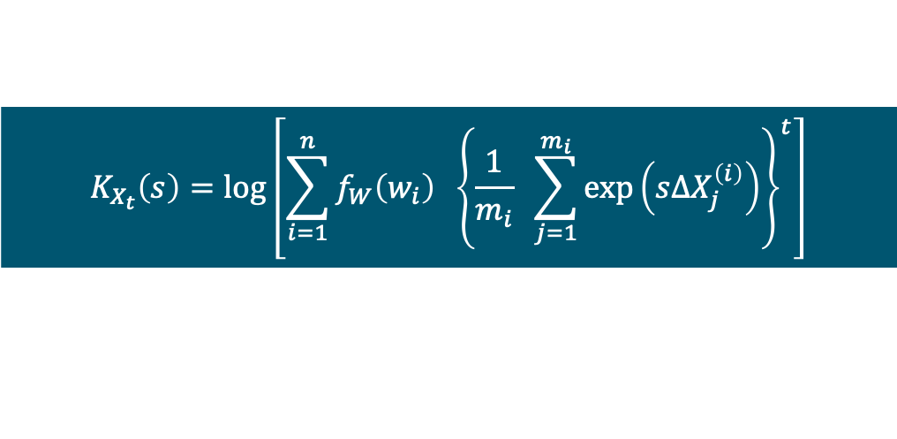
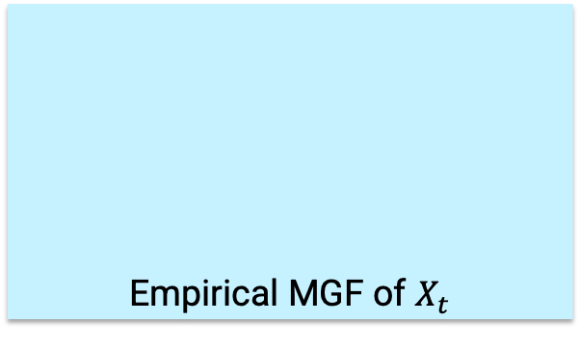

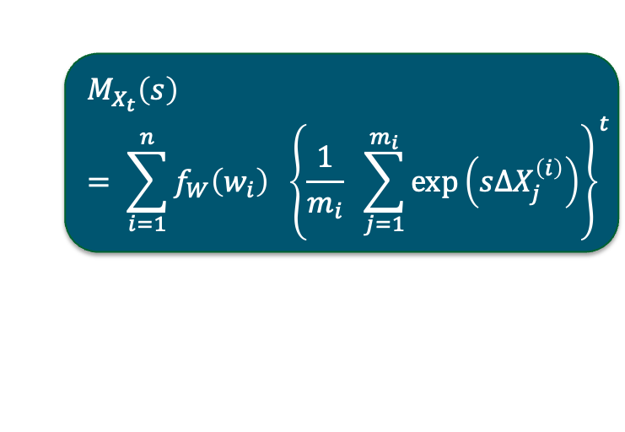
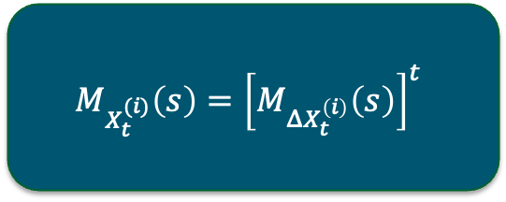
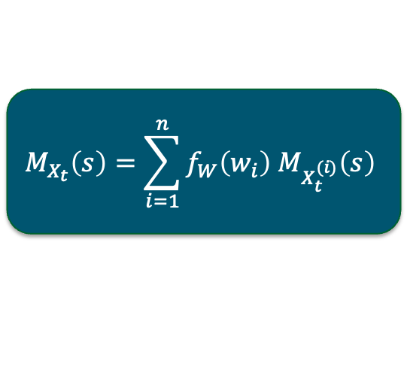
Empirical Cumulant Generating Function for Random Effects
Let random variable $W$ incorporate the unit-to-unit variability, and $f_{W}(w)$ is the PDF of $W$
Empirical MGF of $X_{t}$
Empirical MGF for Degradation of unit $i$
$$M_{X_{t}}\left(s\right)=\sum_{i=1}^{n}{f_{W}\left(w_{i}\right) M_{X_{t}^{(i)}}\left(s\right)}$$
$$M_{X_{t}^{(i)}}\left(s\right)={\left[M_{ΔX_{t}^{\left(i\right)}}\left(s\right)\right]}^{t}$$
$$M_{X_{t}}\left(s\right)= \sum_{i=1}^{n}{f_{W}\left(w_{i}\right) {\left\{\frac{1}{m_{i}} \sum_{j=1}^{m_{i}}{\exp\left(sΔX_{j}^{\left(i\right)}\right)}\right\}}^{t}}$$
Empirical Cumulant Generating Function (ECGF) of $X_{t}$
$$K_{X_{t}}\left(s\right)=\log\left[\sum_{i=1}^{n}{f_{W}\left(w_{i}\right) {\left\{\frac{1}{m_{i}} \sum_{j=1}^{m_{i}}{\exp\left(sΔX_{j}^{\left(i\right)}\right)}\right\}}^{t}}\right]$$

Slide 14
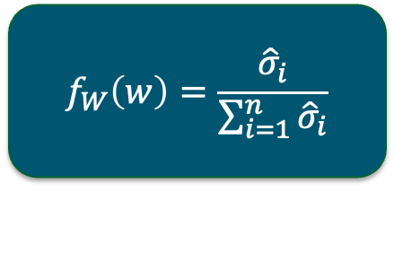
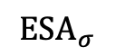
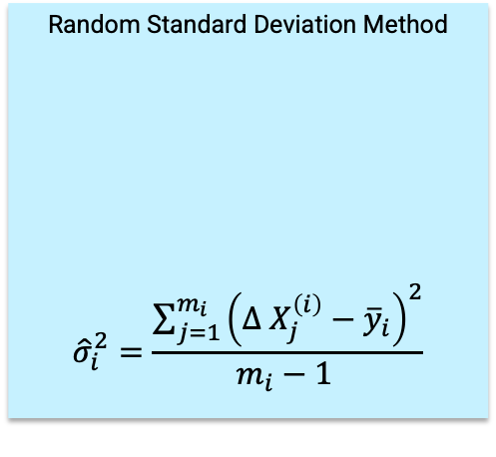
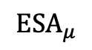
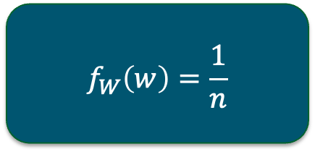
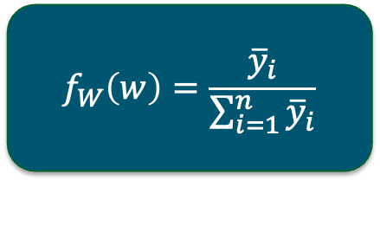
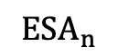
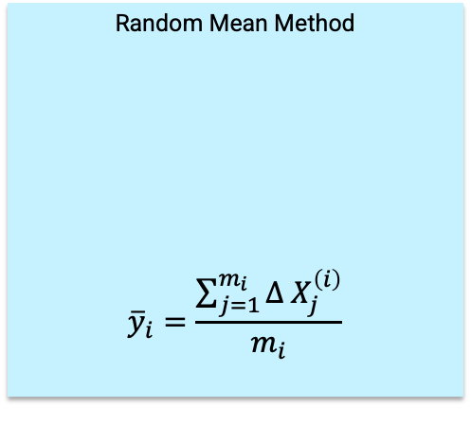
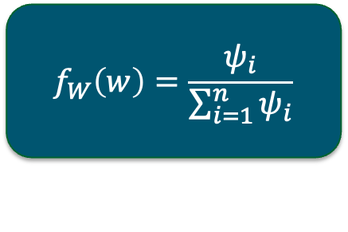
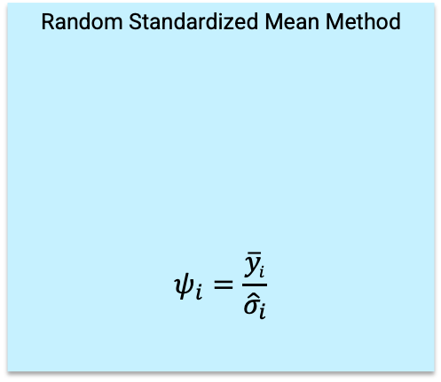
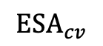
Weighting Methods for the ECGF for Random Effects
$$ESA_{n}$$
$$ESA_{μ}$$
$$ESA_{σ}$$
$$ESA_{cv}$$
Equal Weight Method
Random Mean Method
$${\overline{y}}_{i}=\frac{\sum_{j=1}^{m_{i}}{Δ X_{j}^{\left(i\right)}}}{m_{i}}$$
Random Standard Deviation Method
$${\hat{σ}}_{i}^{2}=\frac{\sum_{j=1}^{m_{i}}{{\left(Δ X_{j}^{\left(i\right)}−{\overline{y}}_{i}\right)}^{2}}}{m_{i}−1 }$$
Random Standardized Mean Method
$$ψ_{i}=\frac{{\overline{y}}_{i}}{{\hat{σ}}_{i}}$$
$$f_{W}\left(w\right)=\frac{1}{n}$$
$$f_{W}\left(w\right)=\frac{{\overline{y}}_{i}}{\sum_{i=1}^{n}{{\overline{y}}_{i}}}$$
$$f_{W}\left(w\right)=\frac{{\hat{σ}}_{i}}{\sum_{i=1}^{n}{{\hat{σ}}_{i}}}$$
$$f_{W}\left(w\right)=\frac{ψ_{i}}{\sum_{i=1}^{n}{ψ_{i}}}$$
Empirical Cumulant Generating Function (ECGF) of $X_{t}$
$$K_{X_{t}}\left(s\right)=\log\left[\sum_{i=1}^{n}{f_{W}\left(w_{i}\right) {\left\{\frac{1}{m_{i}} \sum_{j=1}^{m_{i}}{\exp\left(sΔX_{j}^{\left(i\right)}\right)}\right\}}^{t}}\right]$$

Slide 15
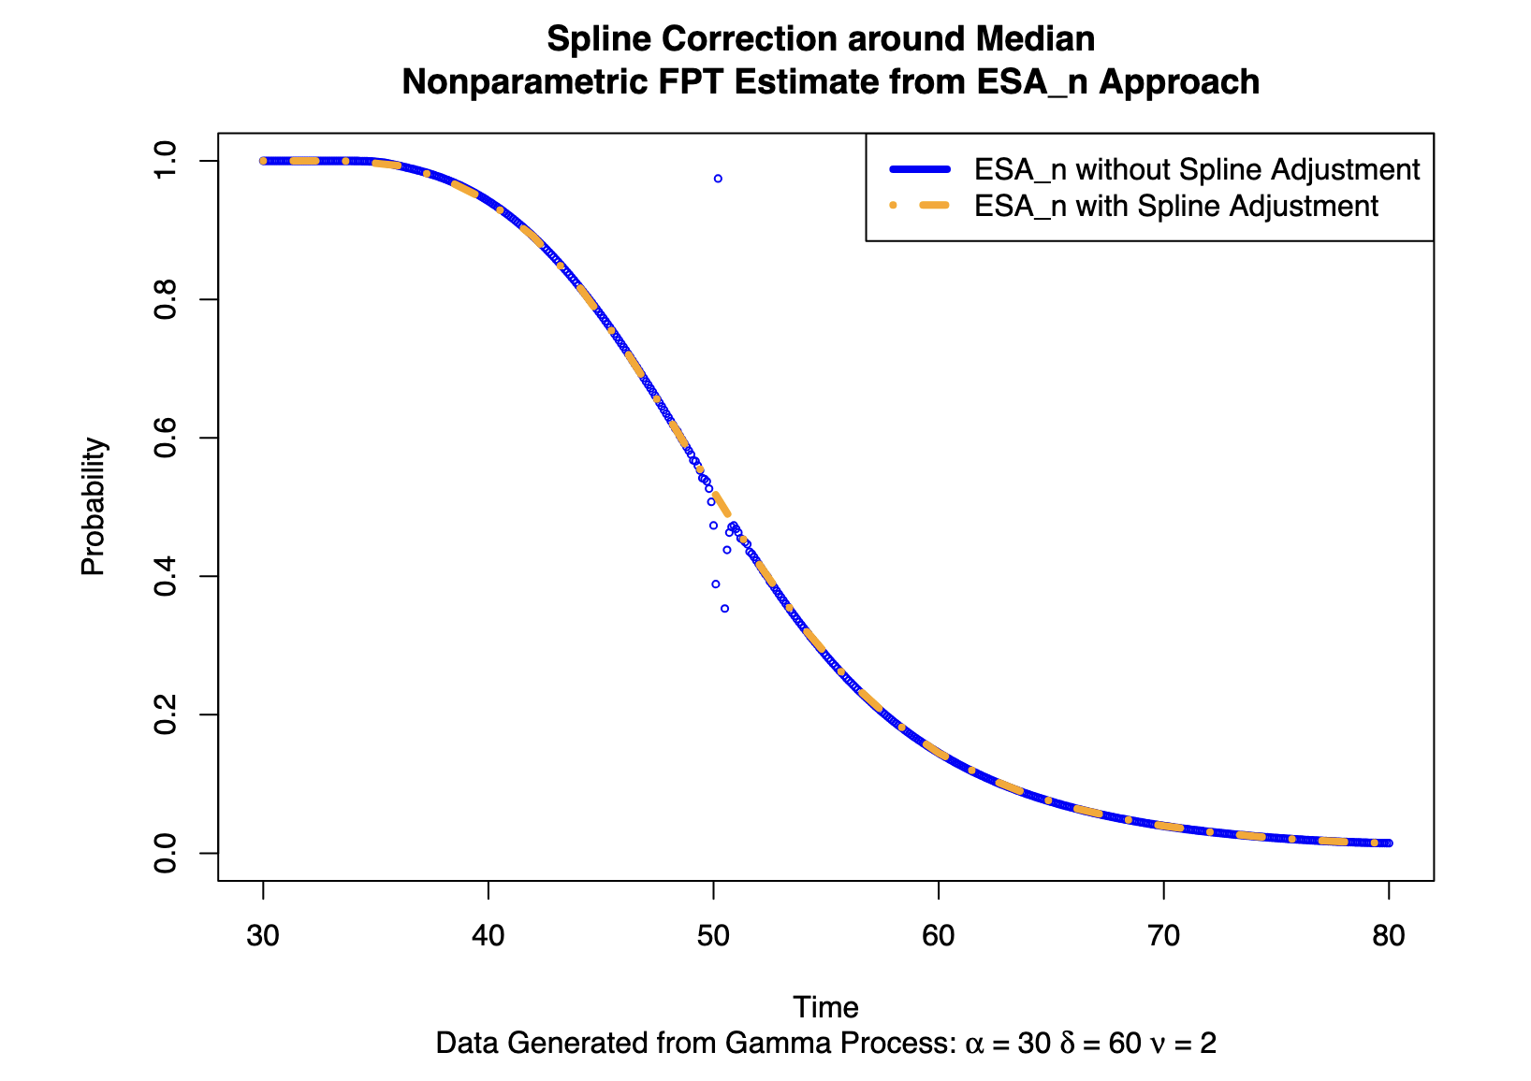
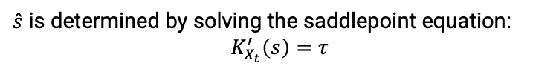
Weight ECGF is applied for saddlepoint approximation to obtain the FPT distribution with random effects
Apply ESA for Random Effects
FPT Distribution
Degradation Data with Random Effects
Evaluate ECGF of $X_{t}$
Evaluate ECGF of 𝑋_𝑡
Select Weight Function $f_{W}\left(w\right)$
Select Weight Function 𝑓_𝑊 (𝑤)
$\hat{s}$ is determined by solving the saddlepoint equation:
$$K_{X_{t}}^{′}\left(s\right)=τ$$

Slide 16
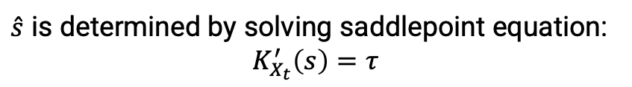
FPT Distribution Estimation with Proposed ESA Method with Random Effects
$\hat{s}$ is determined by solving saddlepoint equation:
$$K_{X_{t}}^{′}\left(s\right)=τ$$

Slide 17
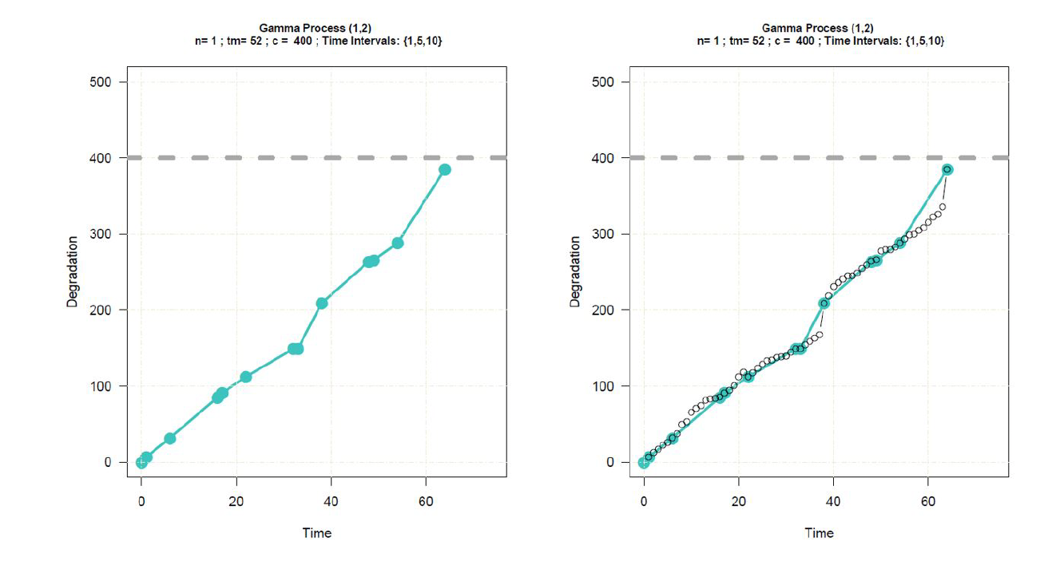
CRImp approach is applied when degradation data are collected with unequal time intervals
FPT Distribution
Degradation Data with Random Effects
Evaluate ECGF of $X_{t}$
Evaluate ECGF of 𝑋_𝑡
Select Weight Function $f_{W}\left(w\right)$
Select Weight Function 𝑓_𝑊 (𝑤)
For each Unit Apply CRImp Algorithm
Make all degradation data equally spaced
CRImp – Conditional Random Imputation Technique
ECGF – Empirical Cumulant Generating Function
FPT – First Passage Time Distribution

Slide 18
Monte Carlo Simulations

Slide 19
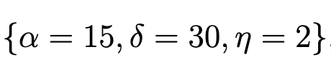
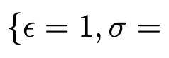
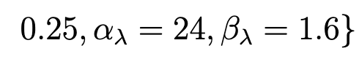
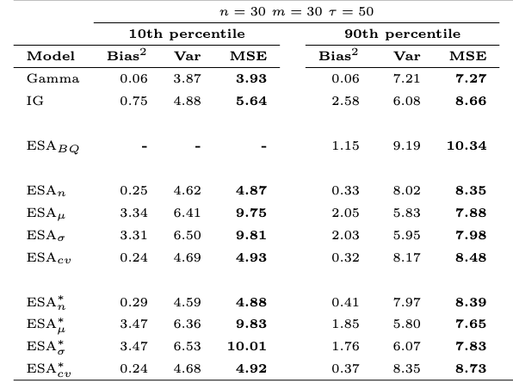
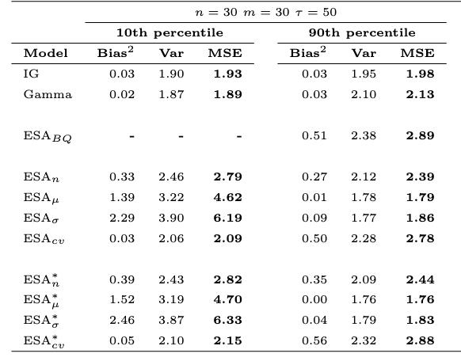
Simulation Results shows that we can eliminate the model misspecification errors with ESA method for higher percentiles
Data Generated from Gamma
Data Generated from Inverse Gaussian

Slide 20
Simulation Results shows that we can eliminate the model misspecification errors with ESA method for higher percentiles
Data Generated from Random Gamma Process

Slide 21
Simulation Results shows that we can eliminate the model misspecification errors with ESA method for higher percentiles
Data Generated from Random IG Process

Slide 22
Applications

Slide 23
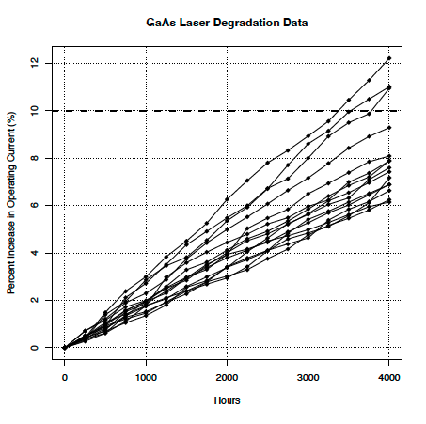
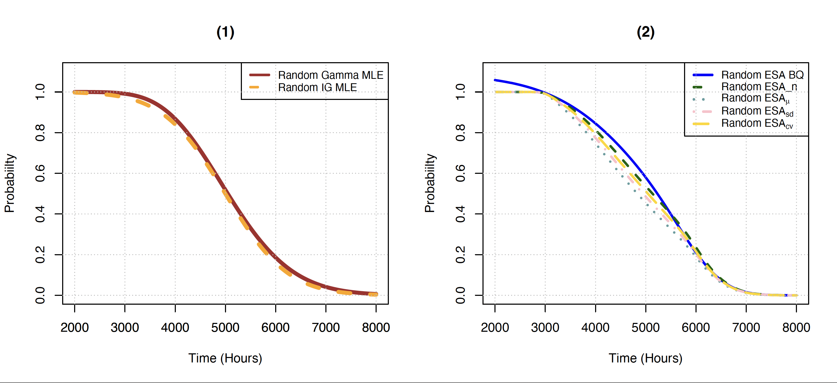
GaAs Laser Data Set in Meeker and Escobar (1998)
 | Random Gamma | Random IG | ESA Random BQ | ESA Equal Weight | ESA Mean | ESA Variance | ESA CV
10-th Percentile | 3858 | 3702 | - | 3617 | 3439 | 3510 | 3556
90-th Percentile | 6448 | 6296 | 6380 | 6414 | 6314 | 6346 | 6373
 | We only consider the measurements at time points {250, 500, 1000, 1750, 2000, 2500, 3250, 3500, 4000} | ESA Equal Weight* | ESA Mean* | ESA Variance* | ESA CV*
10-th Percentile |  | 3615 | 3607 | 3611 | 3615
90-th Percentile |  | 6458 | 6445 | 6458 | 6459

Slide 24
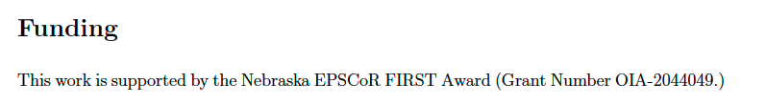
A novel distribution-free approach is proposed to obtain the first passage time distribution with random designs for degradation data
The Distribution-free ESA method is proposed to obtain the FPT with Random Effect
Monte-Carlo simulations show that the ESA method works well particularly for 10-th percentile and MTTF
The GaAs data set (Meeker and Escobar (1998)) is used to model with the proposed approach
Thank you! Questions

Slide 25
